Slide 1
HP Kirchenchor pollham
© Lukas Knoll

Slide 2
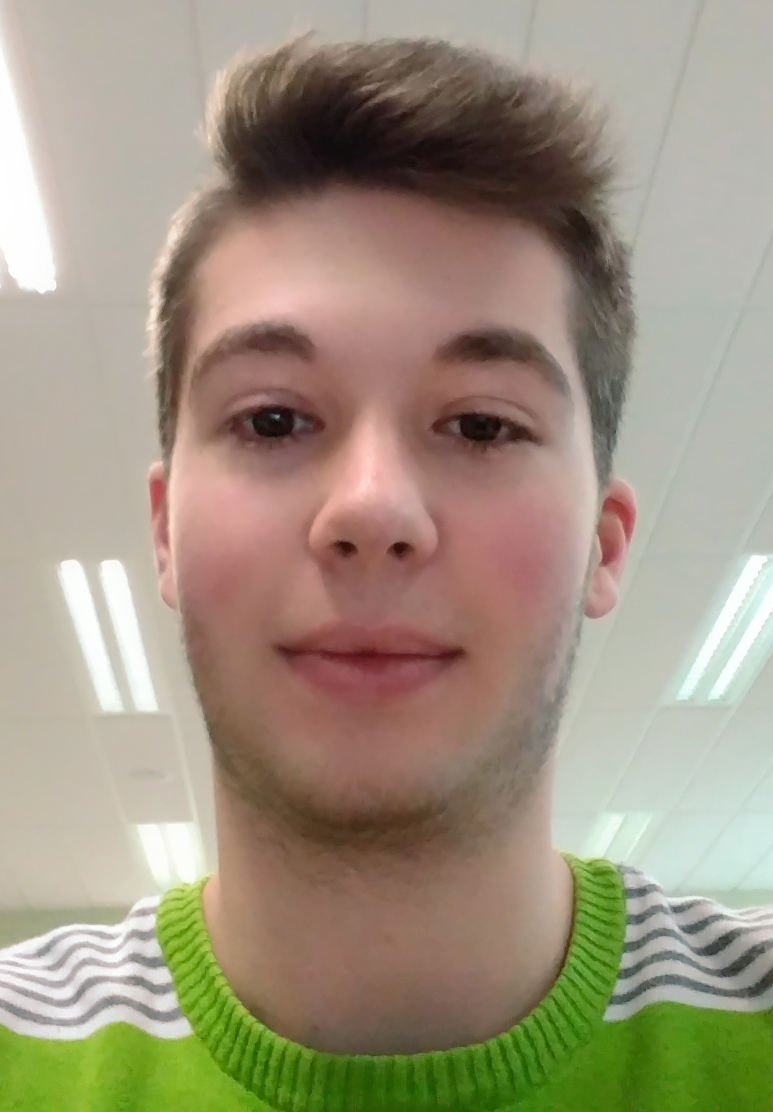
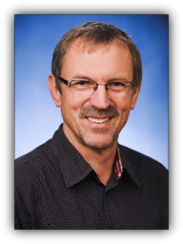
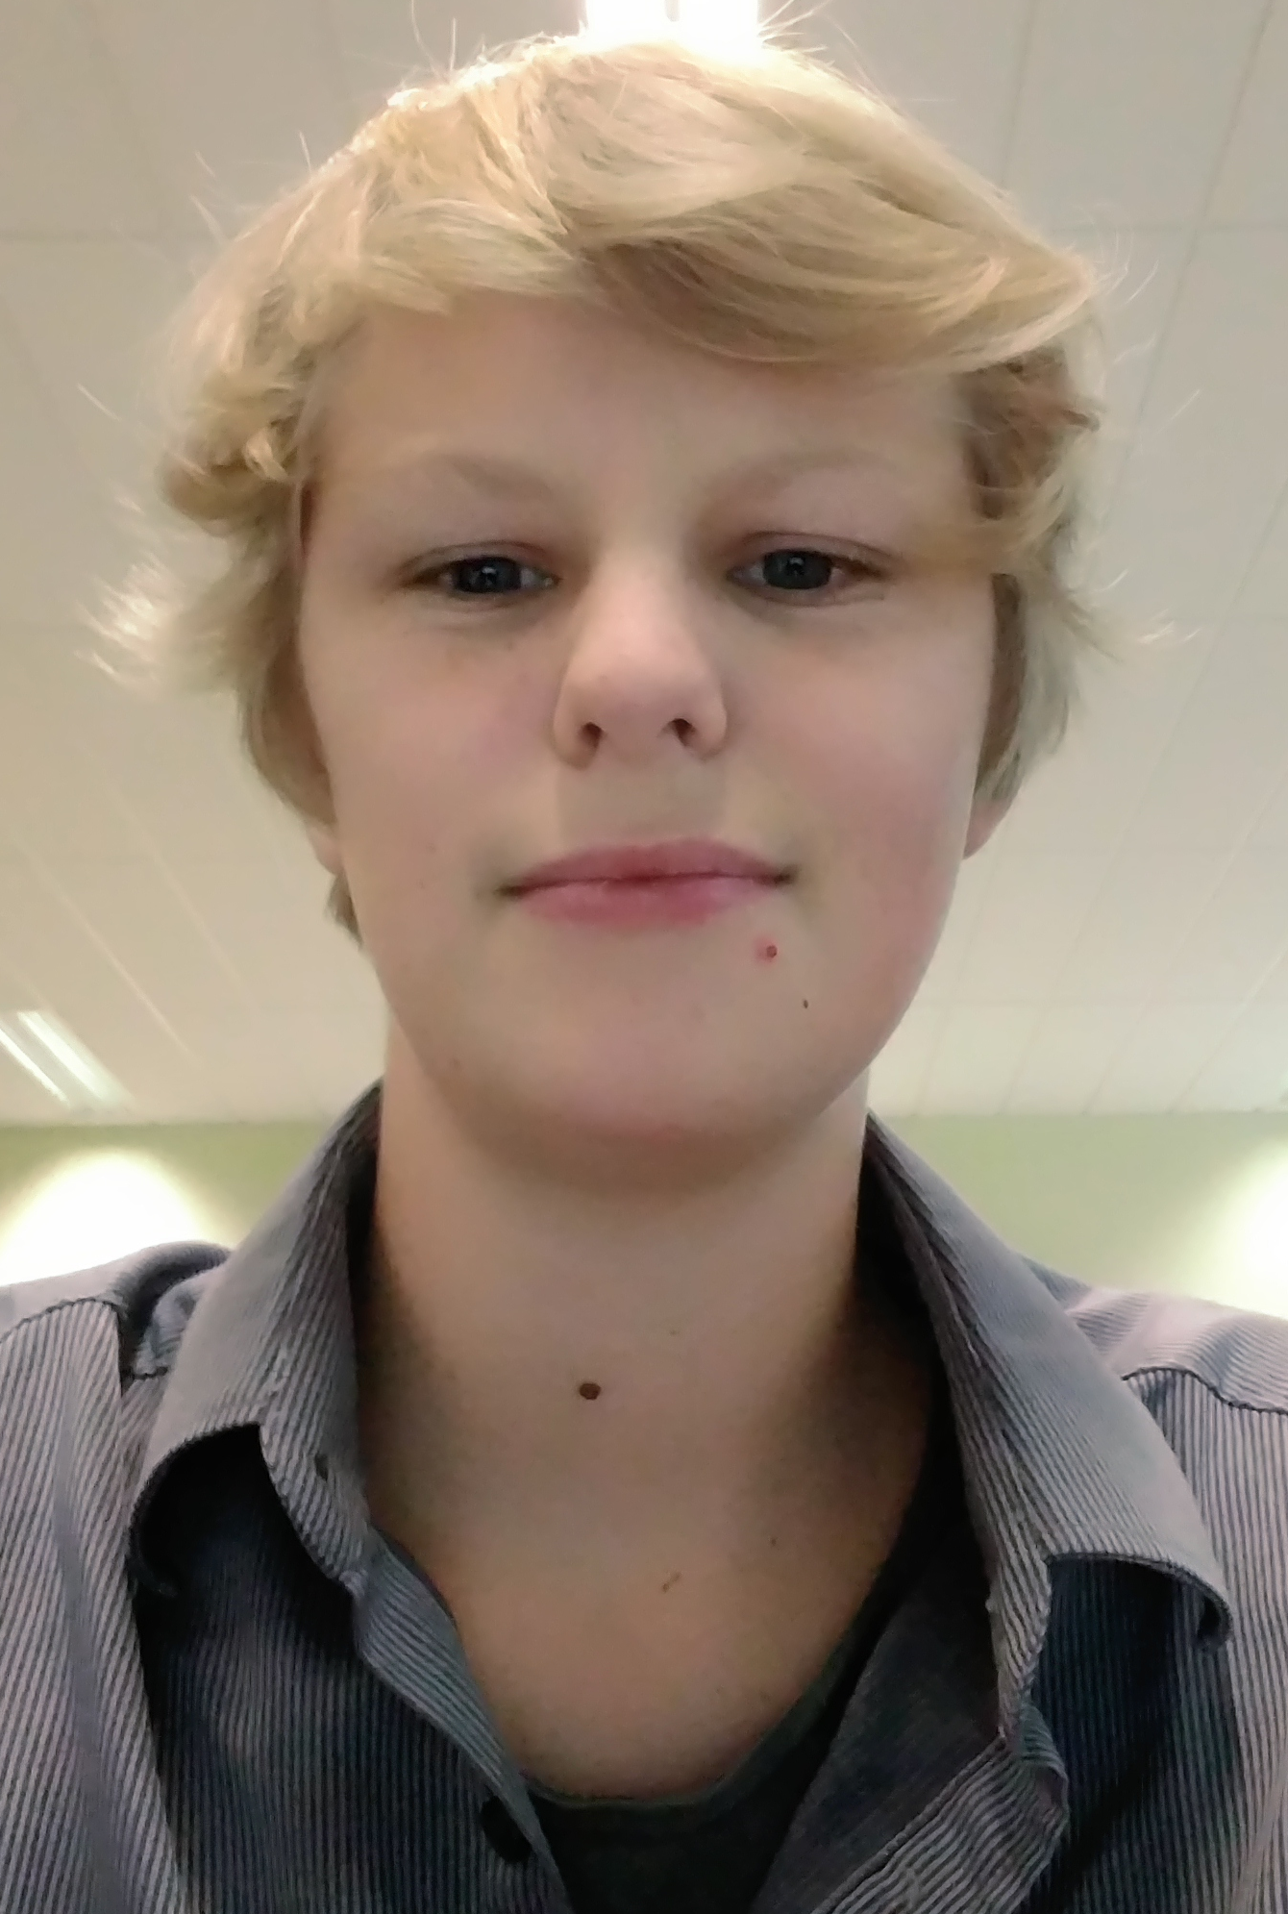
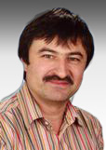
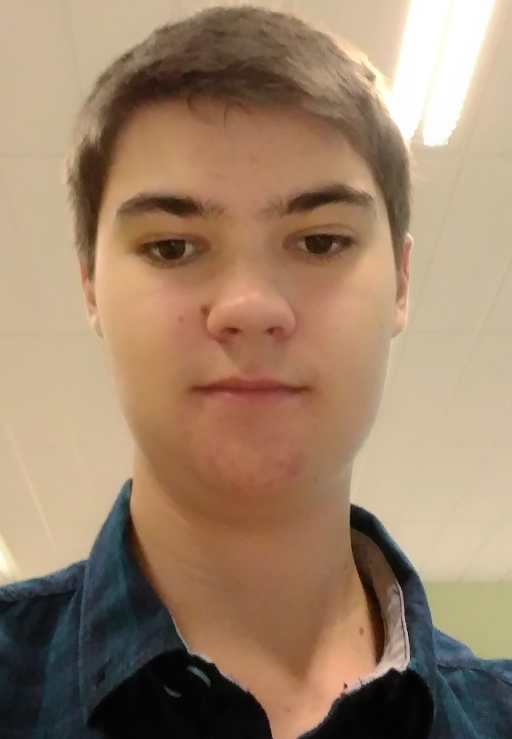
Customer And Team:
Lukas Knoll (Project Manager)
Mag. Wolfgang Froschauer
(Customer)
Niklas Graf (Team Member)
DI Josef Doppelbauer
(Intermediary) Sebastian Mandl (Team Member)

Slide 3
Project Content:
Create a Homepage
Public Area und Private Area
Administration of events through Google Calendar
Store Data through Google Drive
Displaying of music notes and events

Slide 4
Basic Data:
Projectstart: 22.9.2016
Expected Projectend: 30.3.2016
Planned Workinghours: 254
Done Workinghours: 66
Projectclose through installation of the Homepage on a Webserver

